Slide 1
Functionality of the
RSA cipher
CrypTool Team
November 2010

Slide 2






Cryptography and what you need it for
  Sending encrypted messages has always played a major role in the history of humanity.
  In each era there has been important information which had to be kept secret from
  other people.
  Especially in today's society, in the age of internet, it is important to be aware of data security.
Data reaches their receiver indirectly
by passing between several servers.
At each node, the data can be captured,
read and even changed.
Modern cryptography is about securing this data.
Notes:
Istock: 9588509

Slide 3
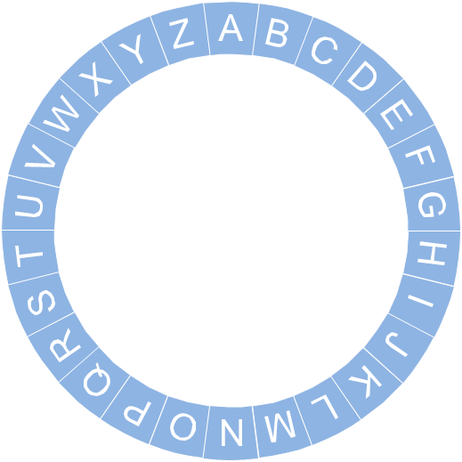
Introductory example: Caesar cipher
  One of the first ways of encrypting a message was the Caesar cipher. The method got
  its name from the ancient emperor Julius Caesar, who used it 2000 years ago to encrypt
  secret messages to his generals.
  Here you can see how it works:
Plaintext
Chipertext
This is a secret
information!
Uijt jt b tfdsfu
jogpsnbujpo!
Vjku ku c ugetgv
kphqtocvkqp!
Wklv lv d vhfuhw
lqirupdwlrq!
Write out the alphabet twice in two concentric circles. Offset the letters of
the inner circle from the outer one by a certain amount.
Now each letter in the plaintext will be replaced by its corresponding letter
in the inner circle. That’s how you get the ciphertext.
Do you want to try this cipher on your own text?
You can try it here.
As there are limited possibilities (only 26 possibilities of different chipertexts),
this cipher is quite easy to break.
!

Slide 4






Model of the RSA cipher
  The goal is to achieve a safe means of communication.
  "Safe" in this case means that even if a message is intercepted, it should not be possible
  for an attacker to read the message.
  How can we realize this security? A modern solution is the RSA cipher.
  The idea of the cipher is as follows:
Then the message can be sent in public, as only the right recipient
will be able to open the padlock with the appropriate key.
The main idea is to separate the padlock from the key. You should publicize copies
of your padlock, as opposed to your key, which you should keep secret.
Now someone who wants to send you a message is able
to encode his or her message with your padlock.
Each participant has a padlock with a matching key.
Notes:
9027968

Slide 5
The essential problem
  The RSA cipher is the electronic implementation of the model described before.
  The cipher got its name from its inventors: Rivest, Shamir and Adleman.
  The algorithm is based on an underlying mathematical problem. Specifically, it is the problem of factoring a given large number into prime numbers.
  When you have a number that is a product of large prime numbers, it is quite hard to find its decomposition. Still today no one has found a fast and effective way of finding the factors.
  The security of RSA is based on this difficulty.
Bit length: 768
Decimal length: 232
Current PCs can quickly factor numbers with about 80 digits.
Therefore, practical RSA implementations must use moduli with at least 300 digits
to achieve sufficient security.
!
Notes:
9027968

Slide 6
How does the RSA cipher work?
To understand how RSA cipher works you need some basic mathematical
concepts. We will explain this in the next slides.
  The modulo operator
1
  Euler‘s totient function
2
  Euler-Fermat theorem
3
Notes:
9027968

Slide 7





Mathematical basics - 1
The modulo operator
  This sign is the modulo operator. With the modulo operation you are interested in the remainder left over from division with an integer number.
  To get a better idea, take a look at the following:
Five people want to share a cake which is already cut into 16 pieces.
Each of them can get three pieces of cake, but one will be left over.
The modulo operator calculates precisely this remainder.
Notes:
http://www.istockphoto.com/stock-illustration-8955603-community-network-kit.php

Slide 8
Mathematical basics - 1
The modulo operator
  This sign is the modulo operator. With the modulo operation you are interested in the remainder left over from division with an integer number.
  To get a better idea, take a look at the following:
Mathematical definition
An example
means that there exists an integer number such that can be represented as
with the condition that:
The modulo operator is commutative with the basic arithmetic operations. For example it does not matter whether you first multiply
or first calculate the modulus and then multiply:
We are not interested in the value of .
The important part is its existence.
Further information can be found in the CrypTool Script (chap. 4.4).
!
?
Notes:
9027968

Slide 9
Mathematical basics - 2
Euler’s totient function
  Euler’s totient function of an integer counts how many whole numbers are both coprime to and smaller than .
  Here how the formula looks:
?
Phi of N is the quantity of positive integers where:
Important properties
Example
Given a number which is product of two factors
and :
Given a prime number :
Therefore , given a number composed of two primes, :
Suppose we want to calculate .
First we find the factor of :
Becauseo and are primes, we can use
the formula given to the left:
Notes:
9027968

Slide 10
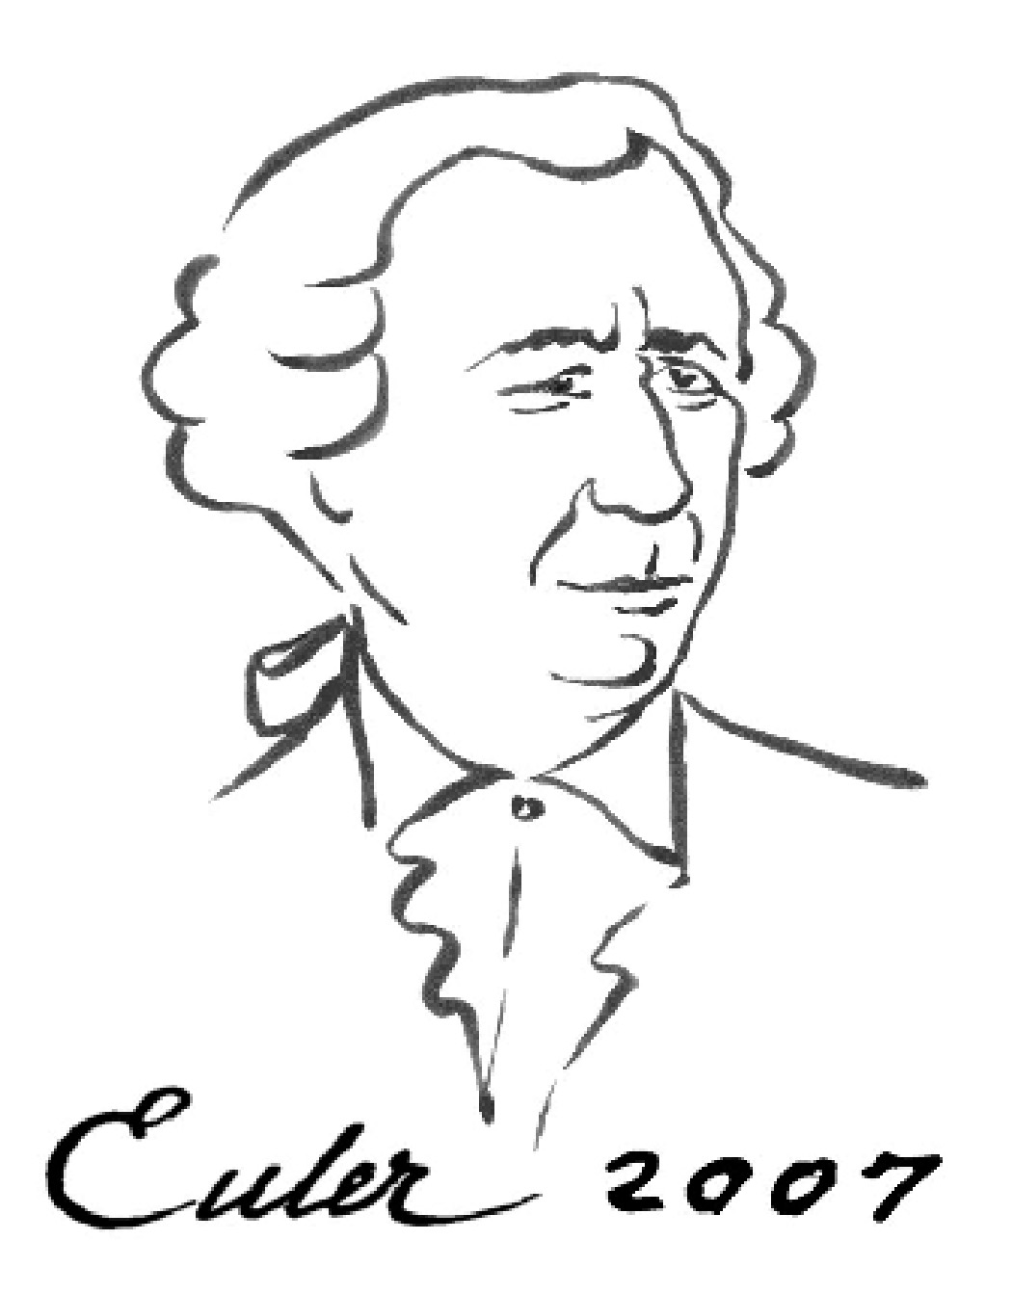
Mathematical basics - 3
The Euler-Fermat theorem
  The last basic equation is the Euler-Fermat theorem.
Given two coprime numbers and :
Modulus calculations operate in the finite set .
A function is called cyclic if, after repeated application, the results repeat themselves within this set.
0
The cycles generated by
this operation both have length , which is exactly .
9
1
9
9
1
1
9
1
9
1
8
2
If you multiply a number by itself, you will, with absolute certainty, reach . again in at most steps.
You can verify this by multiplying both sides of the formula above by .
7
7
7
3
3
7
3
7
3
3
For example, one such cyclic function
is multiplication with a fixed base.
We will choose the numbers and
as the fixed bases. We can multiply each number by itself until we reach it again. In our example
with .
6
4
5
With these basic equations
we can start looking at the actual cipher.
3
9
7
1
3
7
9
3
1
7

Slide 11
Step 1: Generate the keys
  We separate the RSA cipher algorithm into three different steps which will be explained
  on the following slides.
  First we have to generate our RSA keys. This step must be done only once as an initial step.
Formal
Example
Choose two primes and with
Calculate their product:
Calculate the value of Euler’s totient function of
Choose a number between and
which is coprime to
Find another number where
Suppose we select and
Thus:
Suppose we choose , because:
We will select as thus:
1
1
2
2
3
3
4
4
5
5
?
Here you can get more information on
how to find an appropiate number
(by means of the extended Euclidean algorithm)
is the public RSA key.
is the private key.
Notes:
9027968

Slide 12
Step 2: Encrypt messages
  Now we have the requirements to encrypt and decrypt messages.
  First we must convert the letters into numbers to be able to use them in our calculations.
For example you can use the following substitution:
A | B | C | D | … | Z
01 | 02 | 03 | 04 | … | 26
Formal
Example
To encrypt a message we have to calculate
Here is the converted message and is the encoded text, the ciphertext. The numbers and are taken from the public RSA key.
We shall continue our example by encoding
the word “SECRET”:
Now we take the first letter S = 19 and encrypt
it by using the public key:
Following this pattern, ”SECRET“ is encrypted as
follows:
Letters
S | E | C | R | E | T
19 | 05 | 03 | 18 | 05 | 20
Numbers
The presented cipher is simplified. Further information is provided in the next slides.
!
80 | 31 | 61 | 44 | 31 | 76
Notes:
9027968

Slide 13
Step 3: Decrypt Messages
  The receiver gets the message now in its encrypted form only.
Formal
Example
To decipher the original message the receiver
needs to calculate the following:
Here will produce the plaintext. The values
and are saved in the receiver’s private key .
The encrypted message is as follows:
According to the formula given to left, he or she can decipher by using his or her private key :
The complete plaintext is obtained by calculating accordingly for each value.
30 | 31 | 61 | 44 | 31 | 76
Nnumbers
19 | 05 | 03 | 18 | 05 | 20
S | E | C | R | E | T
Letters
Why do you get the plaintext by using these formulas?
You can learn the answer on the following slides.
?
Notes:
9027968

Slide 14
Explanation of the formulas
  The following formulas explain why the receiver will obtain the plaintext from
  the encrypted text.
  First we should examine the process of decryption more precisely.
  Since ,
  Thus . , which is equivalent to , where is an arbitrary integer number.
  We can then derive the following sequence of equations:
  By means of Euler-Fermat theorem, , we get:
  All in all we get the following:
By raising the ciphertext to a higher power,
we reobtain the plaintext.
Notes:
9027968

Slide 15
Security of the cipher
The given example was simplified to make the explanation clearer. If you were to use
the cipher as it was just explained, communication would be insecure.
To avoid this problem, a possible solution is to combine several numbers into a block.
In our example we could unite it as follows an then encode it again in another manner:
In practice, RSA is not used to encrypt text blocks, but rather combined with a symmetric cipher. In this case, RSA is only used to encrypt the key of the symmetric cipher
(Hybrid cryptosystem).
S | E | C | R | E | T
19 | 05 | 03 | 18 | 05 | 20
By encoding each letter to one number, the resulting encryption will
be a one-to-one mapping: for each letter there is just one corresponding
number in the ciphertext.
So an easy way of attacking the ciphertext is by using a frequency analysis.
The idea is that there exists an unequal distribution of letters in each
language. In English the most frequent letter is the letter “E”, so you can
try to replace the most frequent number in the ciphertext with “E”.
30 | 31 | 61 | 44 | 31 | 76
. | E | . | . | E | .
SEC | RET
190503 | 180520
By combining several numbers to a block, we have to pay
attention in choosing our module . It has to be bigger than
the largest possible number in the block.
!
Notes:
9027968

Slide 16
The factorization problem and RSA
  You may be asking yourself why all of this is based on the problem of factoring large numbers.
  We will explain this with the help of our example, as it is easy to find the factors of the number :
  As soon as you have the factorization, you can calculate . By means of and the connection of and with the formula , you can easily find the number , which is
  ‒ together with ‒ the private key. Once you have the private key you can decrypt the entire ciphertext.
  No one has yet found a way to:
    calculate with the help of without knowing the factorization of the number .
    calculate the plaintext from the cipher without knowing the private key .
In fact, by knowing the factorization and the public key it is possible to
generate the private key. Therefore, the attacker could repeat the first step
of the process, the generation of the keys.
!

Slide 17

Further information and references
  http://www.cryptool.org
  An open-source software tool for learning cryptographic ciphers and cryptanalysis
  http://cryptool.org/download/CrypToolScript-en.pdf
  A thorough script with more information about the mathematical aspects of cryptography
  http://en.wikipedia.org/wiki/Cryptography
  Wikipedia article about cryptography in general
  http://en.wikipedia.org/wiki/RSA_cipher
  Wikipedia article about the RSA cipher
  http://www.gax.nl/wiskundePO/
  Online RSA encryption application (Dutch)

