Slide 1

Web - Facebook
A. Ferrari

Slide 2
Punto di partenza
http://developers.facebook.com/docs/reference/plugins/like
A single click on the Like button will 'like' pieces of content on the web and share them on Facebook.
You can also display a Share button next to the Like button to let people add a personal message and customize who they share with.

Slide 3
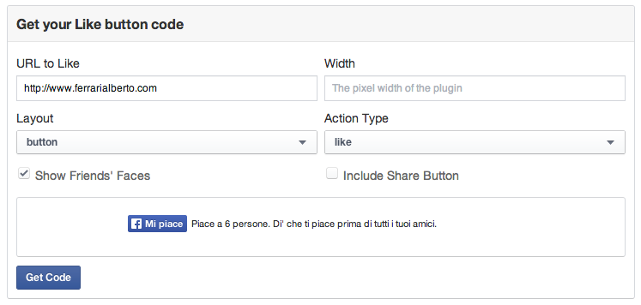
Impostazioni e anteprima

Slide 4
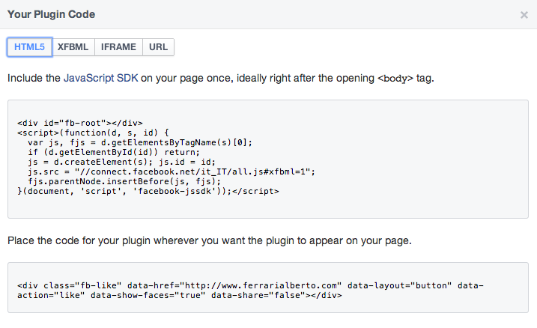
Get code

Slide 5
Esempio di pagina
<html xmlns:fb="http://ogp.me/ns/fb#">
<head><meta http-equiv="Content-Type" content="text/html; charset=UTF-8" />
<meta property="fb:admins" content="Alberto.Ferrari.Parma"/>
<title>Pagina mi piace</title>
<body>
<div id="fb-root">
</div><script>(function(d, s, id) { var js, fjs = d.getElementsByTagName(s)[0]; if (d.getElementById(id)) return; js = d.createElement(s); js.id = id; js.src = "//connect.facebook.net/it_IT/all.js#xfbml=1"; fjs.parentNode.insertBefore(js, fjs);}(document, 'script', 'facebook-jssdk'));</script><div class="fb-like" data-href="http://www.ferrarialberto.com/" data-layout="standard" data-action="like" data-show-faces="true" data-share="true"></div>
</body>
</html>

Slide 6
Un esempio
http://albertoferrari.altervista.org/

